Slide 1
Tree ADT

Slide 2
Objectives
Define trees as data structures
Define the terms associated with trees
Discuss tree traversal algorithms
Discuss a binary tree implementation
Examine a binary tree example
10-<number>

Slide 3
Trees
A tree is a nonlinear data structure used to represent entities that are in some hierarchical relationship
Examples in real life:
  Family tree
  Table of contents of a book
  Class inheritance hierarchy in Java
  Computer file system (folders and subfolders)
  Decision trees
  Top-down design
10-<number>

Slide 4
Example: Computer File System
Root directory of C drive
Documents and Settings
Program Files
My Music
Desktop
Favorites
Start Menu
Adobe
Microsoft Office
10-<number>

Slide 5
Tree Definition
Tree: a set of elements of the same type such that
  It is empty
  Or, it has a distinguished element called the root from which descend zero or more trees (subtrees)
10-<number>
Notes:
Recursive!

Slide 6
Tree Definition
Root
Subtrees of the root
10-<number>

Slide 7
Tree Terminology
Interior nodes
Root
Leaf nodes
10-<number>

Slide 8
Tree Terminology
Nodes: the elements in the tree
Edges: connections between nodes
Root: the distinguished element that is the origin of the tree
  There is only one root node in a tree
Leaf node: a node without an edge to another node
Interior node: a node that is not a leaf node
Empty tree has no nodes and no edges
10-<number>

Slide 9
Tree Terminology
Parent or predecessor: the node directly above in the hierarchy
  A node can have only one parent
Child or successor: a node directly below in the hierarchy
Siblings: nodes that have the same parent
Ancestors of a node: its parent, the parent of its parent, etc.
Descendants of a node: its children, the children of its children, etc.
10-<number>

Slide 10
Discussion
Does a leaf node have any children?
Does the root node have a parent?
How many parents does every node other than the root node have?
10-<number>

Slide 11
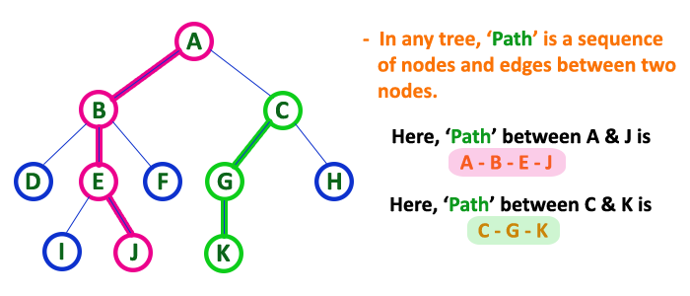
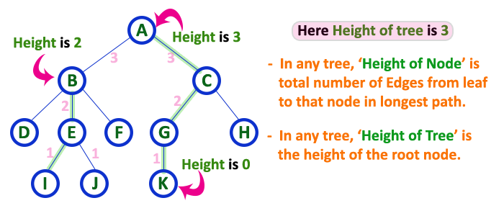
Height of a Tree
A path is a sequence of edges leading from one node to another
Length of a path: number of edges on the path
Height of a (non-empty) tree : length of the longest path from the root to a leaf
  By convention, the height of an empty tree is -1
10-<number>
Notes:
0

Slide 12
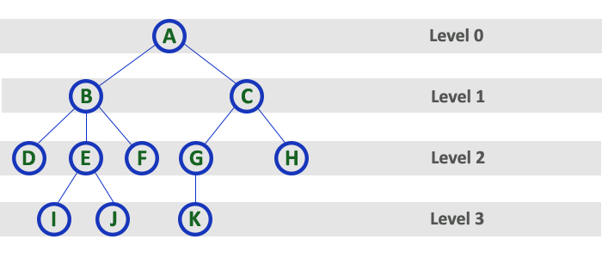
Level of a Node
Level of a node : number of edges between root and node
It can be defined recursively:
  Level of root node is 0
  Level of a node that is not the root node is level of its parent + 1
10-<number>

Slide 13
Level of a Node
Level 0
Level 1
Level 2
Level 3
10-<number>

Slide 14
Subtrees
Subtree of a node: consists of a child node and all its descendants
  A subtree is itself a tree
  A node may have many subtrees
10-<number>

Slide 15
Subtrees
Subtrees of the root node
10-<number>

Slide 16
Subtrees
E
Subtrees of the node labeled E
10-<number>

Slide 17
More Tree Terminology
Degree or arity of a node: the number of children it has
Degree or arity of a tree: the maximum of the degrees of the tree’s nodes
10-<number>

Slide 18
Binary Trees
General tree: a tree each of whose nodes may have any number of children
n-ary tree: a tree each of whose nodes may have no more than n children
Binary tree: a tree each of whose nodes may have no more than 2 children
  i.e. a binary tree is a tree with degree (arity) 2
  The children (if present) are called the left child and right child
10-<number>

Slide 19
Binary Trees
Recursive definition of a binary tree:
it is
  The empty tree
  Or, a tree which has a root whose left and right subtrees are binary trees
A binary tree is a positional tree, i.e. it matters whether the subtree is left or right
10-<number>

Slide 20
Binary Tree
A
B
C
D
E
F
G
H
I
10-<number>

Slide 21
Types of Binary Trees
Degenerate – only one child
Balanced – mostly two children
Complete/Full– always two children
Degenerate binary tree
Balanced binary tree
Full binary tree

Slide 22
Binary Trees Properties
Degenerate
  Height = O(n) for n nodes
  Similar to linear list
Balanced
  Height = O( log(n) ) for n nodes
  Useful for searches
Degenerate binary tree
Balanced binary tree

Slide 23
Binary Search Trees
Key property
  Value at node
    Smaller values in left subtree
    Larger values in right subtree
  Example
    X > Y
    X < Z
X
Y
Z

Slide 24
Examples of Binary Search Tree
Is it a Binary search trees ?
5
10
10
2
45
5
30
5
45
30
2
25
45
2
25
30
10
25
Non-binary search tree
Binary search trees

Slide 25
Exercise
Draw a tree
  44 66 33 50 20
Write pseudo code for same
55
44
66
33
50
20

Slide 26
array representation
each item has a position number
  root is at position 0
  root's left child is at position 1
  root's right child is at position 2
in general:
  left child of i is at 2i + 1
  right child of i is at 2i + 2
  parent of i is at (i-1)/2
0
1 2
3 4 5 6
- - - - - - -
0 1 2 3 4 5 6
0
1 2
6
13
works well if n is known in advance and
there are no "missing" nodes

Slide 27
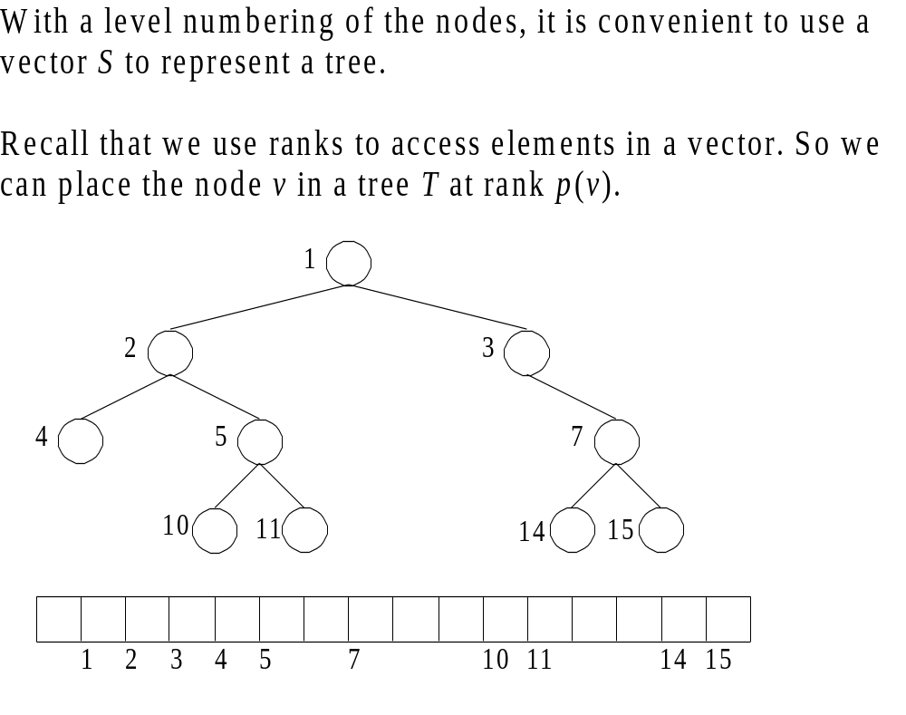
Example

Slide 28
Exercise
  Represent in array form
55
44
66
33
50
20
55
44
66
33
50
20
0
1
2
3
4
5
6
7

Slide 29
linked representation
Start/head
Write Structure for same
root
struct binarytree
{
struct binarytree *left;
int info;
struct binarytree *right;
};
x
x
Left child
Right child
x
x
x
x

Slide 30
Example
55
55
44
66
44
66
33
50
20

Slide 31
Tree Traversals
Process of visiting all nodes of a tree is known as tree traversal.
A traversal of a tree requires that each node of the tree be visited once
  Example: a typical reason to traverse a tree is to display the data stored at each node of the tree
Standard traversal orderings:
  preorder
  inorder
  postorder
  level-order
10-<number>

Slide 32
Traversals
A
B
C
D
E
F
G
H
I
We’ll trace the different traversals using this tree; recursive calls, returns, and “visits” will be numbered in the order they occur
10-<number>

Slide 33
Preorder Traversal
Start at the root
Visit each node, followed by its children; we will choose to visit left child before right
Recursive algorithm for preorder traversal:
  If tree is not empty,
    Visit root node of tree
    Perform preorder traversal of its left subtree
    Perform preorder traversal of its right subtree
  What is the base case?
  What is the recursive part?
10-<number>

Slide 34
Preorder Traversal(RoLR)
1: visit A
2
24
23
45
3: visit B
25: visit C
4
16
26
38
15
22
37
44
39: visit G
5: visit D
17: visit E
27: visit F
.
.
.
.
.
6
8
18
28
21
40
19
34
36
41
43
7
14
20
35
42
9: visit H
29: visit I
.
.
.
.
30
33
10
13
11
12
31
32
Nodes are visited in the order ABDHECFIG
10-<number>

Slide 35
Preorder Traversal
void preOrder(treePointer ptr)
{
if (ptr != NULL)
{
visit(t);
preOrder(ptr->leftChild);
preOrder(ptr->rightChild);
}
}
Notes:
Ptr points to the root of the subtree being traversed.

Slide 36
Preorder Example (Visit = print)
a
b
c
a
b
c

Slide 37
Preorder Example (Visit = print)
a
b
c
f
d
e
g
j
h
i
a
b
d
g
h
e
i
c
f
j
Notes:
During the traversal, t starts at the root, moves to the left child b of the root, then to the left child d of b. When the traversal of the left subtree of b is complete, t, once again, points to the node b. The t moves into the right subtree of b. When the traversal of this right subtree is complete, t again points to b. Following this, t points to a. We see that t points to every node in the binary tree three times – once when you get to the node from its parent (or in the case of the root, t is initially at the root), once when you return from the left subtree of the node, and once when you return from the node’s right subtree. Of these three times that t points to a node, the node is visited the first time.

Slide 38
Preorder Of Expression Tree
/
*
+
e
f
+
-
a
b
c
d
/
*
+
a
b
-
c
d
+
e
f
Gives prefix form of expression!

Slide 39
Inorder Traversal
Start at the root
Visit the left child of each node, then the node, then any remaining nodes
Recursive algorithm for inorder traversal
  If tree is not empty,
    Perform inorder traversal of left subtree of root
    Visit root node of tree
    Perform inorder traversal of its right subtree
10-<number>

Slide 40
Inorder Traversal(LRoR)
23: visit A
1
24
22
45
14: visit B
37: visit C
2
15
25
38
13
21
36
44
41:
visit G
5: visit D
18: visit E
33: visit F
.
.
.
.
.
3
6
16
26
20
39
17
32
35
40
43
4
12
19
34
42
9: visit H
29: visit I
.
.
.
.
27
31
7
11
8
28
10
30
Nodes are visited in the order DHBEAIFCG
10-<number>

Slide 41
Inorder Traversal
void inOrder(treePointer ptr)
{
if (ptr != NULL)
{
inOrder(ptr->leftChild);
visit(ptr);
inOrder(ptr->rightChild);
}
}

Slide 42
Inorder Example (Visit = print)
a
b
c
b
a
c

Slide 43
Inorder Example (Visit = print)
a
b
c
f
d
e
g
j
h
i
g
d
h
b
e
i
a
f
j
c

Slide 44
Inorder By Projection (Squishing)
a
b
c
f
d
e
g
j
h
i
g
d
h
b
e
i
a
f
j
c

Slide 45
Inorder Of Expression Tree
/
*
+
e
f
+
-
a
b
c
d
a
+
b
*
c
-
d
/
e
+
f
Gives infix form of expression (sans parentheses)!

Slide 46
Postorder Traversal
Start at the root
Visit the children of each node, then the node
Recursive algorithm for postorder traversal
  If tree is not empty,
    Perform postorder traversal of left subtree of root
    Perform postorder traversal of right subtree of root
    Visit root node of tree
10-<number>

Slide 47
Postorder Traversal(LRRo)
45: visit A
1
23
22
44
21: visit B
43: visit C
2
14
24
36
13
20
35
42
41:
visit G
12: visit D
19: visit E
34: visit F
.
.
.
.
.
3
5
15
25
18
37
16
31
33
38
40
4
11
17
32
39
10: visit H
30: visit I
.
.
.
.
26
29
6
9
7
8
27
28
Nodes are visited in the order HDEBIFGCA
10-<number>

Slide 48
Postorder Traversal
void postOrder(treePointer ptr)
{
if (ptr != NULL)
{
postOrder(ptr->leftChild);
postOrder(ptr->rightChild);
visit(t);
}
}

Slide 49
Postorder Example (Visit = print)
a
b
c
b
c
a

Slide 50
Postorder Example (Visit = print)
a
b
c
f
d
e
g
j
h
i
g
h
d
i
e
b
j
f
c
a

Slide 51
Postorder Of Expression Tree
/
*
+
e
f
+
-
a
b
c
d
a
b
+
c
d
-
*
e
f
+
/
Gives postfix form of expression!

Slide 52
Traversal Applications
a
b
c
f
d
e
g
j
h
i
Make a clone.
Determine height.
Determine number of nodes.
Notes:
Make a clone using postorder traversal … clone the left subtree, clone the right subtree, clone the root in the visit step.
Determine height using postorder traversal … determine the height of the left subtree, determine the height of the right subtree, in the visit step add 1 to the max of the already determined heights of the left and right subtrees.
Determine number of nodes using preorder, inorder, or postorder traversal … initialize a counter to 0, add 1 to the counter in the visit step.

Slide 53
Discussion
Note that the relative order of the recursive calls in preorder, inorder and postorder traversals is the same
The only differences stem from where the visiting of the root node of a subtree actually takes place
10-<number>

Slide 54
Level Order Traversal
Start at the root
Visit the nodes at each level, from left to right
10-<number>

Slide 55
Level Order Traversal
A
B
C
D
E
F
G
H
I
Nodes will be visited in the order ABCDEFGHI
10-<number>

Slide 56
Level Order
Let ptr be a pointer to the tree root.
while (ptr != NULL)
{
visit node pointed at by ptr and put its children on a FIFO queue;
if FIFO queue is empty, set ptr = NULL;
otherwise, delete a node from the FIFO queue and call it ptr;
}

Slide 57
Level-Order Example (Visit = print)
a
b
c
f
d
e
g
j
h
i
a
b
c
d
e
f
g
h
i
j

Slide 58
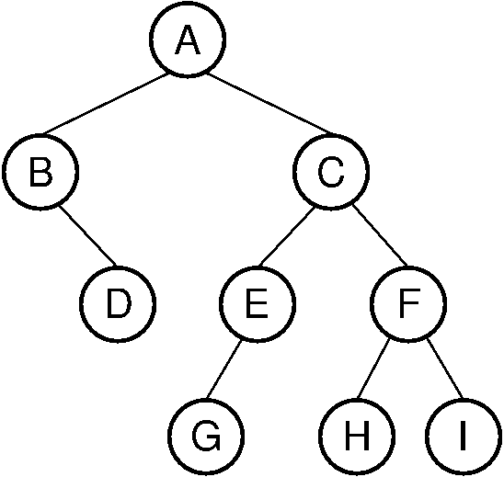
Exercise
Pre- Order Traversal
In-order
Post-order

Slide 59
Solution
Preorder is A B D C E G F H I.
Inorder is B D A G E C H F I.
Postorder is D B G E H I F C A.

Slide 60
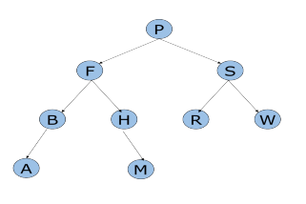
Exercise-2

Slide 61
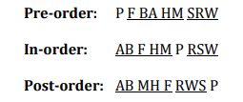
Solution

Slide 62
Exercise
Q . Write function for non recursive traversal of Binary Tree
(a) In order (b) Pre order and (c) Post order.
Q . Write a function to count the number of leaf nodes in a binary tree.
CHAPTER 5

Slide 63
Iterative Inorder Traversal
(using stack)
void iter_inorder(tree_pointer node)
{
int top= -1; /* initialize stack */
tree_pointer stack[MAX_STACK_SIZE];
for (;;) {
for (; node; node=node->left_child)
add(&top, node);/* add to stack */
node= delete(&top);
/* delete from stack */
if (!node) break; /* empty stack */
printf(“%D”, node->data);
node = node->right_child;
}
}
O(n)
CHAPTER 5

Slide 64
#include <stdio.h>
#include <stdlib.h>
/* A binary tree node has data, pointer to left child
and a pointer to right child */
struct node
{
int data;
struct node* left;
struct node* right;
};
/* Function to get the count of leaf nodes in a binary tree*/
unsigned int getLeafCount(struct node* node)
{
if(node == NULL)
return 0;
if(node->left == NULL && node->right==NULL)
return 1;
else
return getLeafCount(node->left)+
getLeafCount(node->right);
}
CHAPTER 5

Slide 65
/* Helper function that allocates a new node with the
given data and NULL left and right pointers. */
struct node* newNode(int data)
{
struct node* node = (struct node*)
malloc(sizeof(struct node));
node->data = data;
node->left = NULL;
node->right = NULL;
return(node);
}
/*Driver program to test above functions*/
int main()
{
/*create a tree*/
struct node *root = newNode(1);
root->left = newNode(2);
root->right = newNode(3);
root->left->left = newNode(4);
root->left->right = newNode(5);
/*get leaf count of the above created tree*/
printf("Leaf count of the tree is %d", getLeafCount(root));
getchar();
return 0;
}
CHAPTER 5

Slide 66
Level Order Traversal
(using queue)
void level_order(tree_pointer ptr)
/* level order tree traversal */
{
int front = rear = 0;
tree_pointer queue[MAX_QUEUE_SIZE];
if (!ptr) return; /* empty queue */
addq(front, &rear, ptr);
for (;;) {
ptr = deleteq(&front, rear);
CHAPTER 5

Slide 67
if (ptr) {
printf(“%d”, ptr->data);
if (ptr->left_child)
addq(front, &rear,
ptr->left_child);
if (ptr->right_child)
addq(front, &rear,
ptr->right_child);
}
else break;
}
}
+ * E * D / C A B
CHAPTER 5

Slide 68
Copying Binary Trees
tree_poointer copy(tree_pointer original)
{
tree_pointer temp;
if (original) {
temp=(tree_pointer) malloc(sizeof(node));
if (IS_FULL(temp)) {
fprintf(stderr, “the memory is full\n”);
exit(1);
}
temp->left_child=copy(original->left_child);
temp->right_child=copy(original->right_child);
temp->data=original->data;
return temp;
}
return NULL;
}
postorder
CHAPTER 5

Slide 69
Binary Tree Construction
Suppose that the elements in a binary tree are distinct.
Can you construct the binary tree from which a given traversal sequence came?
When a traversal sequence has more than one element, the binary tree is not uniquely defined.
Therefore, the tree from which the sequence was obtained cannot be reconstructed uniquely.

Slide 70
Some Examples
preorder = ab
a
a
b
b
inorder = ab
b
a
a
b
postorder = ab
b
b
a
a
level order = ab
a
a
b
b

Slide 71
Binary Tree Construction
Can you construct the binary tree, given two traversal sequences?
Depends on which two sequences are given.

Slide 72
Preorder And Postorder
preorder = ab
a
a
postorder = ba
b
b
Preorder and postorder do not uniquely define a binary tree.
Nor do preorder and level order (same example).
Nor do postorder and level order (same example).

Slide 73
Inorder And Preorder
inorder = g d h b e i a f j c
preorder = a b d g h e i c f j
Scan the preorder left to right using the inorder to separate left and right subtrees.
a is the root of the tree; gdhbei are in the left subtree; fjc are in the right subtree.
a
gdhbei
fjc

Slide 74
Inorder And Preorder
a
gdhbei
fjc
preorder = a b d g h e i c f j
b is the next root; gdh are in the left subtree; ei are in the right subtree.
a
b
fjc
gdh
ei

Slide 75
Inorder And Preorder
a
b
fjc
gdh
ei
preorder = a b d g h e i c f j
d is the next root; g is in the left subtree; h is in the right subtree.
a
b
fjc
d
ei
g
h

Slide 76
Inorder And Postorder
Scan postorder from right to left using inorder to separate left and right subtrees.
inorder = g d h b e i a f j c
postorder = g h d i e b j f c a
Tree root is a; gdhbei are in left subtree; fjc are in right subtree.

Slide 77
Inorder And Level Order
Scan level order from left to right using inorder to separate left and right subtrees.
inorder = g d h b e i a f j c
level order = a b c d e f g h i j
Tree root is a; gdhbei are in left subtree; fjc are in right subtree.

Slide 78
Arithmetic Expression Tree
Binary tree for an arithmetic expression
  internal nodes: operators
  leaves: operands
Example: arithmetic expression tree for the expression
((2 × (5 - 1)) + (3 × 2))
+
×
×
2
−
3
2
5
1

Slide 79
Print Arithmetic Expressions
inorder traversal:
  print “(“ before traversing left subtree
  print operand or operator when visiting node
  print “)“ after traversing right subtree
void printTree(t)
//binary operands only
  if (t.left != null)
  print("(");
    printTree (t.left);
  print(t.element );
  if (t.right != null)
    printTree (t.right);
  print (")");
+
×
×
2
−
3
2
((2 × (5 - 1)) + (3 × 2))
5
1

Slide 80
Evaluate Arithmetic Expressions
postorder traversal
  Recursively evaluate subtrees
  Apply the operator after subtrees are evaluated
int evaluate (t)
//binary operators only
  if (t.left == null)
  //external node
  return t.element;
  else //internal node
  x = evaluate (t.left);
  y = evaluate (t.right);
  let o be the operator
  t.element
  z = apply o to x and y
  return z;
+
×
×
2
−
3
2
5
1

Slide 81
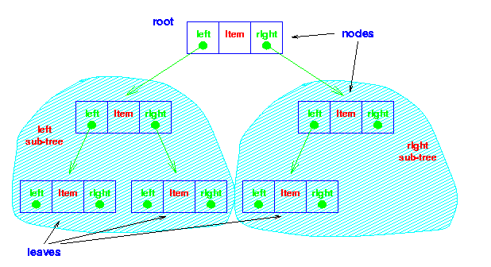

Slide 82
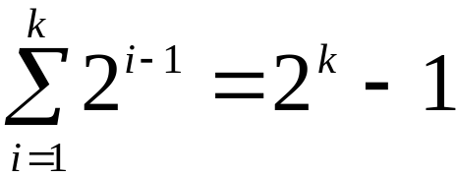
Maximum Number of Nodes in BT
The maximum number of nodes on level i of a binary tree is 2^{i-1}, i>=1.
The maximum number of nodes in a binary tree of depth k is 2^{k}-1, k>=1.
Prove by induction.

Slide 83
Relations between Number of
Leaf Nodes and Nodes of Degree 2
For any nonempty binary tree, T, if n0 is the
number of leaf nodes and n2 the number of nodes
of degree 2, then n0=n2+1
proof:
Let n and B denote the total number of nodes &
branches in T.
Let n0, n1, n2 represent the nodes with no children,
single child, and two children respectively.
n= n0+n1+n2, B+1=n, B=n1+2n2 ==> n1+2n2+1= n,
n1+2n2+1= n0+n1+n2 ==> n0=n2+1

Slide 84
Full BT vs. Complete BT
A full binary tree of depth k is a binary tree of
depth k having 2 -1 nodes, k>=0.
A binary tree with n nodes and depth k is
complete iff its nodes correspond to the nodes numbered from 1 to n in the full binary tree of depth k.
k
A
A
B
C
B
C
D
E
F
G
D
E
F
G
H
H
I
J
K
L
M
N
O
I
Complete binary tree
Full binary tree of depth 4

Slide 85
Binary Tree Representations
If a complete binary tree with n nodes (depth =
log n + 1) is represented sequentially, then for
any node with index i, 1<=i<=n, we have:
  parent(i) is at i/2 if i!=1. If i=1, i is at the root and
  has no parent.
  leftChild(i) is at 2i if 2i<=n. If 2i>n, then i has no
  left child.
  rightChild(i) is at 2i+1 if 2i +1 <=n. If 2i +1 >n,
  then i has no right child.

Slide 86
Linked Representation
typedef struct tnode *ptnode;
typedef struct tnode {
int data;
ptnode left, right;
};
data
left
data
right
left
right

